Slide 1
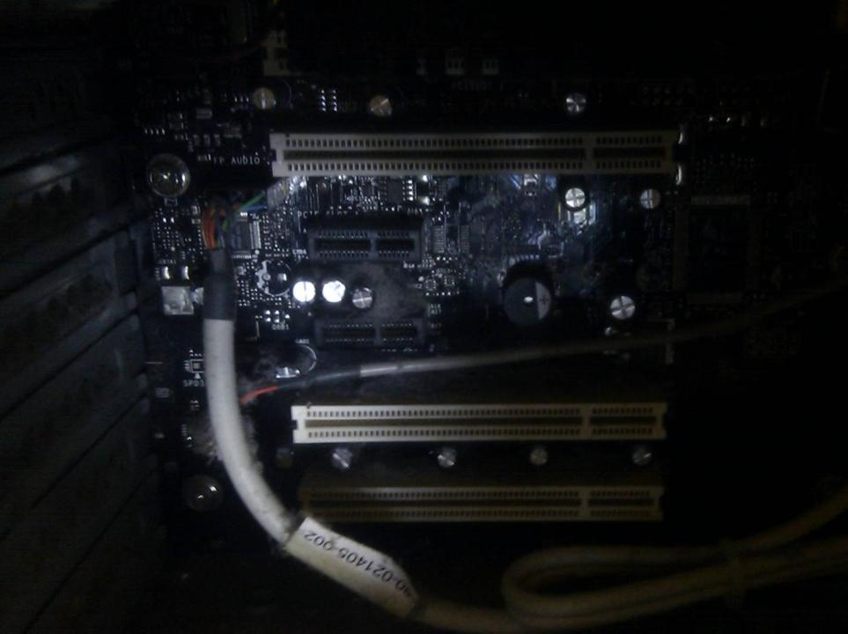

Computing Systems
Operating Systems & Virtual Memory

Slide 2
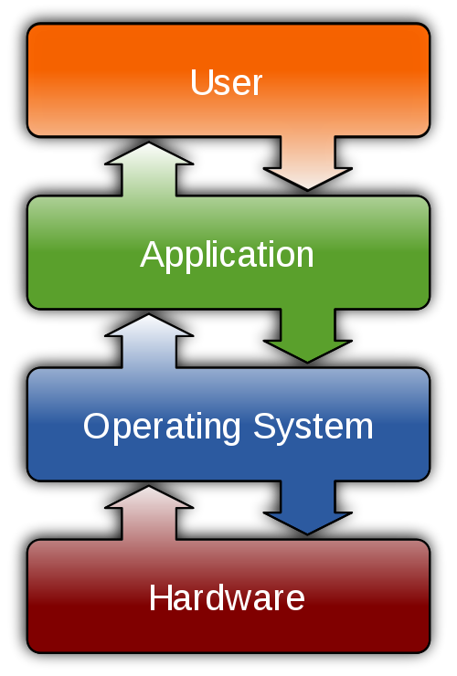

Slide 3
Operating Systems
Software that sits between applications (e.g. office applications or games) and the hardware itself

Slide 4
Features and Components
Kernel Space/User Space
Process management
Interrupts & I/O
Memory management
File system
Device drivers
Networking (TCP/IP, UDP)
Security (Process/Memory protection)
Notes:
List taken from http://en.wikipedia.org/wiki/Operating_system CC-BY-SA

Slide 5
Popular Operating Systems
Windows
*nix (Unix family of operating systems – including Mac OS X, Linux, iOS, Android and many others)
DOS (pre-Windows Operating Systems for PCs)
Also: Symbian, WebOS, BlackBerry OS, ...

Slide 6
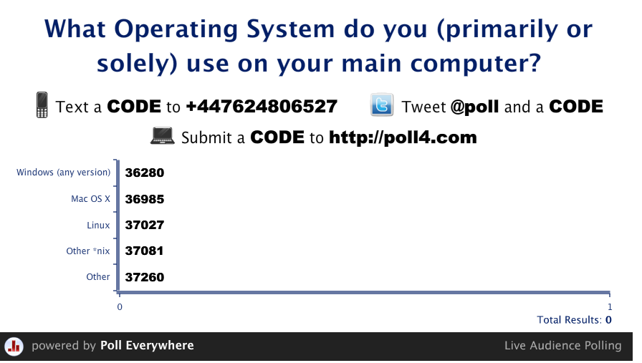
Results

Slide 7
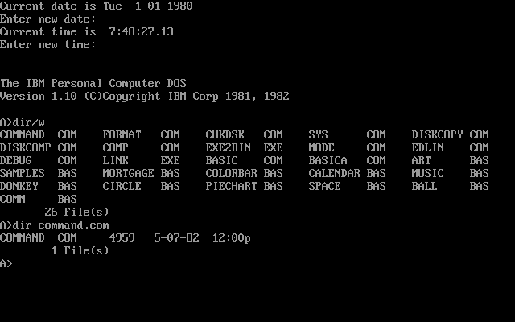
Notes:
This is PC-Dos – the IBM version of MS-DOS, the same DOS as sold by Microsoft, but with the IBM name instead.
Other companies sold compatible DOS systems for PCs, but Microsoft’s licensing agreement with IBM allowed Microsoft to become the dominant software company for Operating Systems – and to exploit this to grow into other areas of computing.

Slide 8
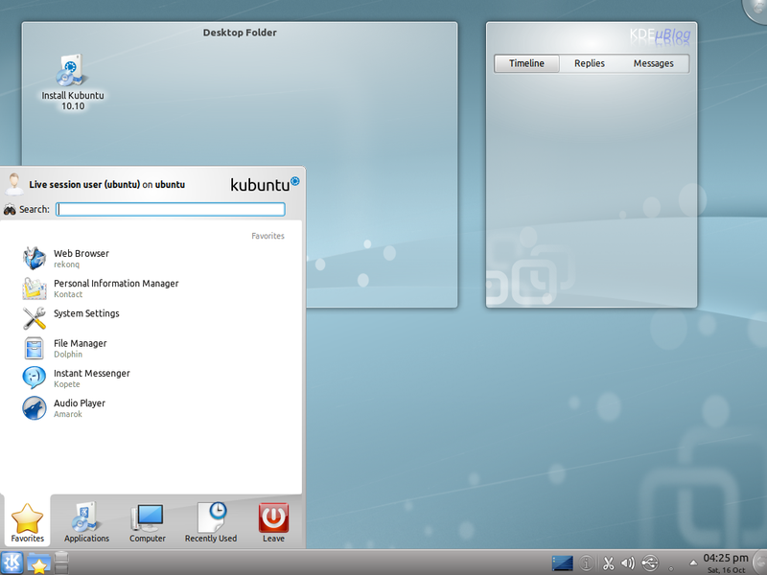
Notes:
This image shows an Ubuntu KDE desktop (Kubuntu). Ubuntu is a popular Linux distribution. Linux is open source, and the license allows companies or individuals to create their own distributions or versions. The Linux OS can work with (or without!) a GUI component. The X Windows System (aka X11) provides the GUI API, but two distinct front-ends desktop environments with their own sets of applications have emerged: KDE and Gnome. (Prior to KDE and Gnome, *nix applications had generally inconsistent GUIs and often looked visually poor in comparison to e.g. Windows or Mac OS)

Slide 9
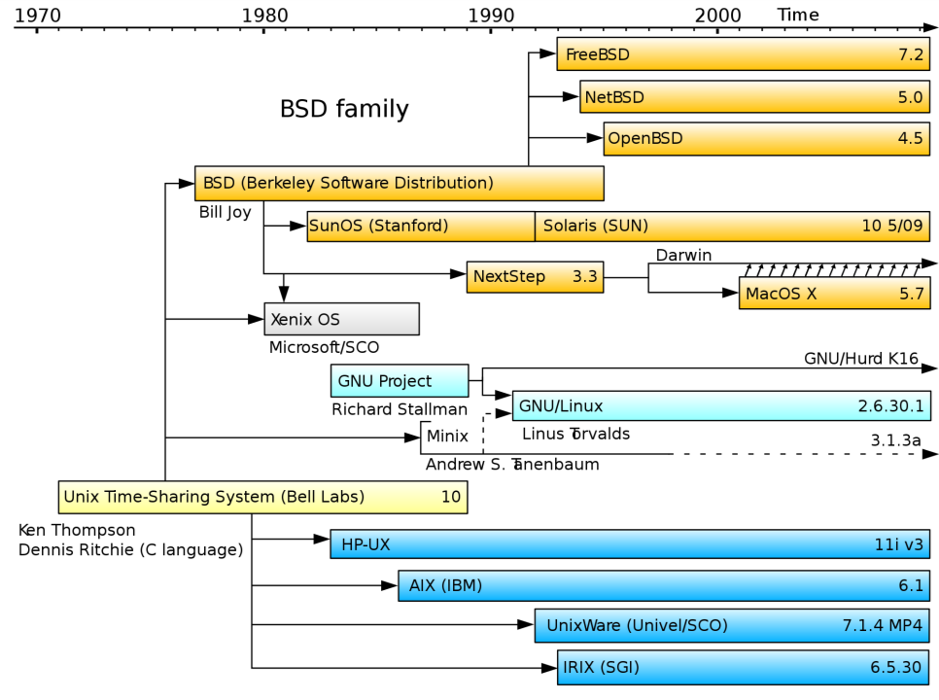
Notes:
The UNIX family has a long and convoluted history.
A multi-user OS underdevelopment by Bell Labs, MIT and GE ‘Multics’ was innovative but problematic. Bell Labs tried again. A team including Ken Thompson, Dennis Ritchie and Brian Kernighan developed Unics – then renamed Unix. Along the way, Ritchie and Kernighan created the C programming language to write the new OS.
Overtime many versions of UNIX were developed, with many major IT companies having their own version – including Microsoft.

Slide 10


Notes:
GNU (GNU is Not Unix), Tux the Penguin (Linux mascot)
The GNU project started in 1983 by Richard Stallman with the goal of creating a complete free and Open Source version of the UNIX operating system. Over the following years the GNU project was able to make substantial progress with the new OS, creating much of the software required – compilers, editors, libraries and utilities. But progress was slow in developing the OS Kernel – the core of the new OS. In 1991 Linus Torvalds wrote and released Linux – an OS core that could be used with GNU to create a complete and usable OS.

Slide 11
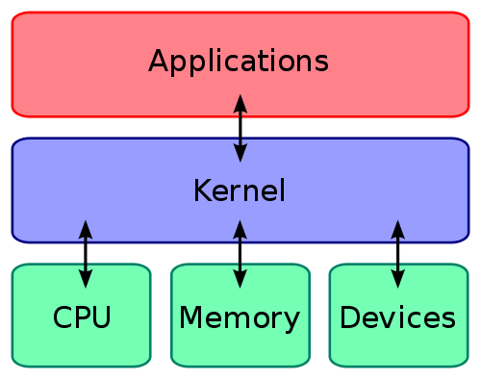
The Kernel
Most basic set of OS functionality exists in the OS Kernel
Kernel has some key tasks:
  Manage different running processes
  Allocate memory
  Process I/O
Kernel may also perform
file management, run
device drivers, and carry
out a range of other tasks
Notes:
Linux actually refers to the Kernel – GUI and many other elements are not part of the core of Linux. A Linux distribution is made up (typically) of the Linux Kernel, a windowing system, desktop environment and a range of applications. The kernel itself is much more limited... Which is why some Linux systems look very different to one another.

Slide 12
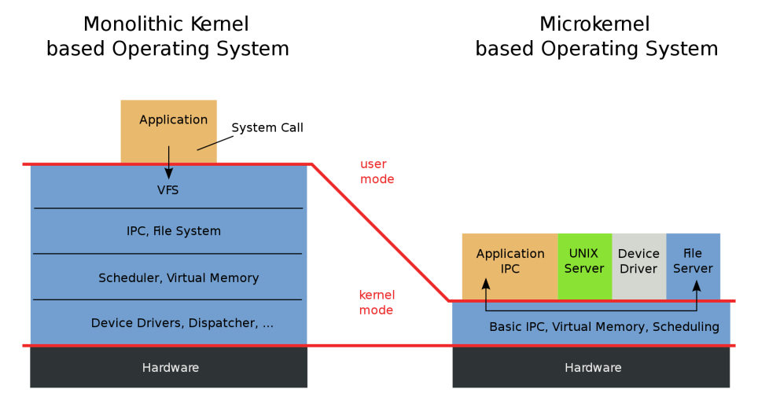
Notes:
Windows and Linux both use a fairly monolithic kernel design. Micro-kernels move parts of the operating system into services that run outside of the kernel. This can mean that some failures (in e.g. The file server or with device drivers) are less likely to cause crashes, and the system may be more secure. The cost is that there may be a performance hit.
IPC = “Inter Process Communication”
VFS = “Virtual File System” – more later...

Slide 13
User Space (User Mode)
Kernel Space has direct access to the memory used by the operating system itself
  Security issues exist in making this accessible to all applications
Applications and OS modules may exist in a User Space
  Limits direct access to the memory of other applications and to hardware
  Forces programs to use the kernel API interface
Notes:
User space provides some protection to the system from malicious or poorly written programs that might crash or damage the system.
A little more on this later!

Slide 14
Process Management
Modern OS allow multiple programs to be run by a computer at one time
  Even if there is only one processor
Requires OS to switch between running programs/processes
  If one process is waiting for user input, pause it and run a different process
Some process may need to interact
  OS manages Inter-Process Communication (IPC)

Slide 15
Multi-Processing & Multi-Tasking
Multi-Processing uses multiple processors (or processor cores) to run multiple tasks (programs)
Multi-Tasking allows multiple tasks to run on one or more processors
  May have multiple tasks per processor
  Rapid switching between tasks, performing a little bit of each, allows computer to give the appearance of running all the tasks at the same time

Slide 16
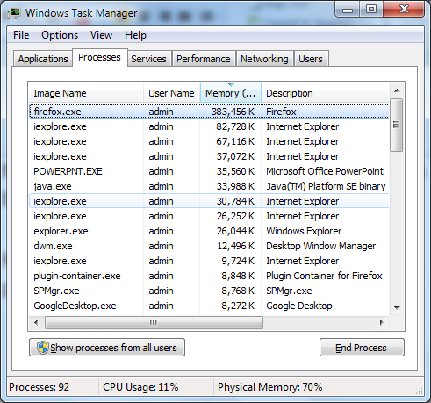

Slide 17
Three State Process Management
Process waiting for I/O (or a signal from another process) is BLOCKED
States and transitions:
  RUNNING: The process that is currently being executed
  READY: A process that is queuing and prepared to execute when given the opportunity
  BLOCKED: A process that cannot execute until some event occurs, such as the completion of an I/O operation
Notes:
States and transitions text from http://en.wikipedia.org/wiki/Process_management_(computing) (CC-BY-SA)
Transitions (again, text from Wikipedia, as above):
Processes entering the system must go initially into the READY state, processes can only enter the RUNNING state via the READY state. Processes normally leave the system from the RUNNING state. For each of the three states, the process occupies space in main memory. While the reason for most transitions from one state to another might be obvious, some may not be so clear.
RUNNING → READY The most common reason for this transition is that the running process has reached the maximum allowable time for uninterrupted execution; i.e. time-out occurs. Other reasons can be the imposition of priority levels as determined by the scheduling policy used for the Low Level Scheduler, and the arrival of a higher priority process into the READY state.
RUNNING → BLOCKED A process is put into the BLOCKED state if it requests something for which it must wait. A request to the OS is usually in the form of a system call, (i.e. a call from the running process to a function that is part of the OS code). For example, requesting a file from disk or a saving a section of code or data from memory to a file on disk.

Slide 18
Process Transitions
Running
Dispatch
Block
Timeout/
suspend
Ready
Blocked
Wakeup
Notes:
With pre-emptive multitasking, the OS will regularly pause or block running processes to allow other processes to run. Co-operative multitasking requires process to voluntarily suspend or block themselves. These is also a five state variant of this diagram. From wikipedia http://en.wikipedia.org/wiki/Process_management_(computing) (CC-BY-SA) :
Five-state process management model
While the three state model is sufficient to describe the behavior of processes with the given events, we have to extend the model to allow for other possible events, and for more sophisticated design. In particular, the use of a portion of the hard disk to emulate main memory (so called virtual memory) requires additional states to describe the state of processes which are suspended from main memory, and placed in virtual memory (on disk). Of course, such processes can, at a future time, be resumed by being transferred back into main memory. The Medium Level Scheduler controls these events. A process can be suspended from the RUNNING, READY or BLOCKED state, giving rise to two other states, namely, READY SUSPEND and BLOCKED SUSPEND. A RUNNING process that is suspended becomes READY SUSPEND, and a BLOCKED process that is suspended becomes BLOCKED SUSPEND. A process can be suspended for a number of reasons; the most significant of which arises from the process being swapped out of memory by the memory management system in order to free memory for other processes. Other common reasons for a process being suspended are when one suspends execution while debugging a program, or when the system is monitoring processes. For the five-state process management model, consider the following transitions described in the next sections.
BLOCKED → BLOCKED SUSPEND If a process in the RUNNING state requires more memory, then at least one BLOCKED process can be swapped out of memory onto disk. The transition can also be made for the BLOCKED process if there are READY processes available, and the OS determines that the READY process that it would like to dispatch requires more main memory to maintain adequate performance.
BLOCKED SUSPEND → READY SUSPEND A process in the BLOCKED SUSPEND state is moved to the READY SUSPEND state when the event for which it has been waiting occurs. Note that this requires that the state information concerning suspended processes be accessible to the OS.
READY SUSPEND → READY When there are no READY processes in main memory, the OS will need to bring one in to continue execution. In addition, it might be the case that a process in the READY SUSPEND state has higher priority than any of the processes in the READY state. In that case, the OS designer may dictate that it is more important to get at the higher priority process than to minimise swapping.
READY → READY SUSPEND Normally, the OS would be designed so that the preference would be to suspend a BLOCKED process rather than a READY one. This is because the READY process can be executed as soon as the CPU becomes available for it, whereas the BLOCKED process is taking up main memory space and cannot be executed since it is waiting on some other event to occur. However, it may be necessary to suspend a READY process if that is the only way to free a sufficiently large block of main memory. Finally, the OS may choose to suspend a lower-priority READY process rather than a higher-priority BLOCKED process if it believes that the BLOCKED process will be ready soon.

Slide 19
Multi-Threading: Processes and Threads
Each process has its own private memory space
  When switching between processes, the memory context also needs switched
Threads work similarly to processes, except threads can share a memory context
  Switching between threads in a process is faster
  Shared access to data across threads rather than needing to pass data between processes

Slide 20
I/O and Interrupts
Already looked at interrupts and I/O
Operating System responsible for taking inputs and passing these onto user applications where necessary
  E.g. Passing mouse click or key press to the current application

Slide 21
Device Drivers
Programs written to work with specific hardware systems – and to provide a simpler, abstract, interface to the OS and applications
  Kernel space and user space drivers
OS and application developers should not need to know the specific low-level details of all the different hardware systems that might be used
  Cannot know about future devices

Slide 22
Main Memory
Memory address space gives a unique numerical address to every byte
  Or set of bytes
Addresses start at zero
Possible size of address space depends on computer design
  E.g. 32 bit x86 CPUs limited to 4 GB physical memory
 |  | ...
 | 5FFF | A
 | 5FFE | T
 | 5FFD | A
 | 5FFC | D
 |  | ...
 | 0004 | E
 | 0003 | M
 | 0002 | O
 | 0001 | S
 | 0000
Notes:
The first computers and first home computers had minimal OS memory management. Only one program could be run at a time, and it would have access to all of the computers main memory. In the 1970’s and 80’s this was often used (and abused) by expert programmers to squeeze the maximum performance possible from the computers of the time. Parts of main memory were also given over to system I/O – to the extent that by writing data values to specific addresses of main memory, output could be drawn to the screen, or locations in memory directly read to obtain input.

Slide 23
Memory Pages & Segments
Instead of using physical address of each byte, can use a system where a memory address is stored as a reference to a page or segment of memory
  Plus offset to data in the block
Early architectures had very tight limits on the address space available to individual programs (64K on early PCs)
  Segment:Offset addressing increased total available memory

Slide 24
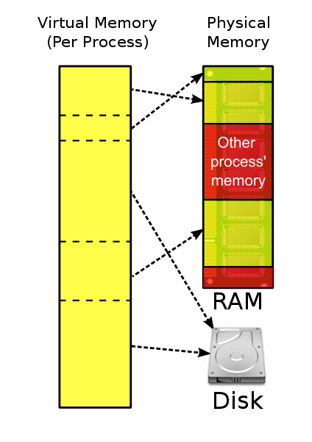
Virtual Memory
With limited physical memory, multi-process OS could struggle to fit all programs into memory
Virtual Memory allows the use of secondary storage to give the appearance of more memory than actually exists

Slide 25
Virtual Memory
On disk swap files or swap partitions used to add virtual memory to physical memory
Programs may have partial residence
  Partly in physical memory, partly in VM
Scatter loading allows different programs to exist on pages scattered through the physical and virtual memory
Scatter loading and partial residence is invisible to the applications themselves

Slide 26
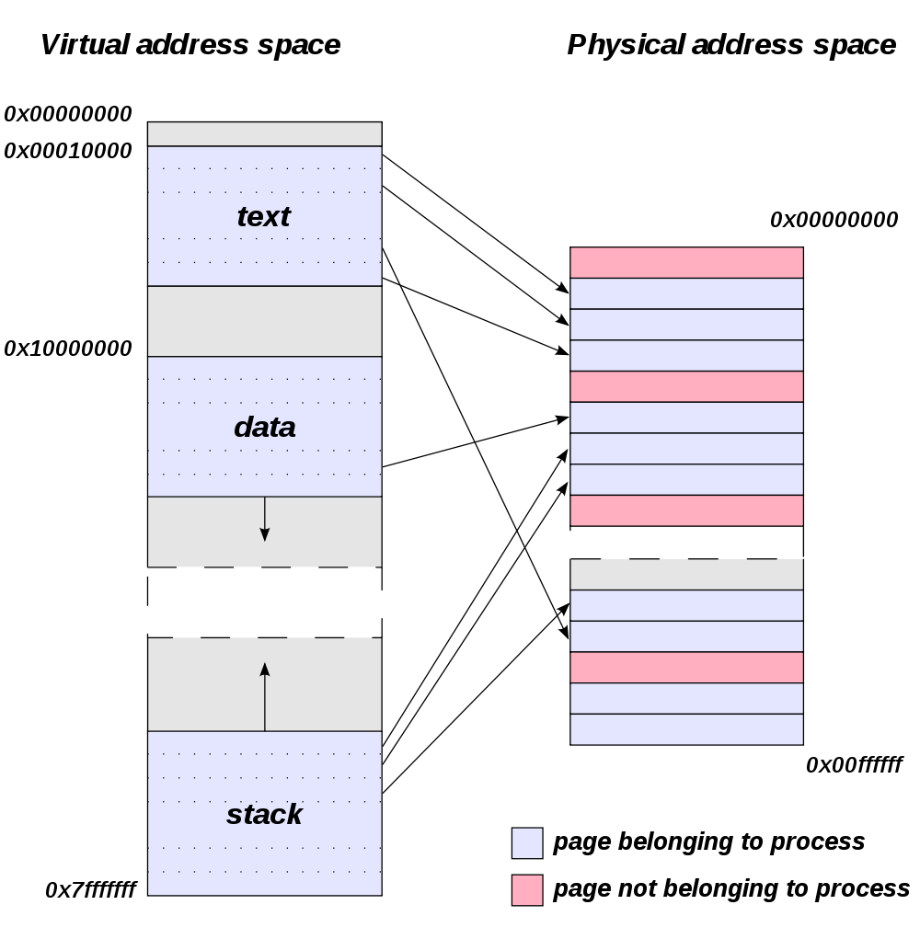
Page Table
Table maps virtual addresses to physical addresses
Notes:
From: http://en.wikipedia.org/wiki/Page_table
Relationship between pages addressed by virtual addresses and the frames in physical memory, within a simple address space scheme. Physical memory can contain pages belonging to many processes. Pages can be swapped to disk if used infrequently, or if physical memory is full. Not all pages are in physical memory in the above diagram.

Slide 27
Virtual Memory Operation
Application attempts to access a VM address
OS checks virtual memory address on page table
  If page currently in memory (a page ‘hit’), the physical address is returned
  Else (a page ‘miss’) the page needs loaded into physcial memory, perhaps replacing an existing page which gets copied out to disk (swap)
Thrashing can occur when low physical memory requires constant disk swapping

Slide 28
Virtual Memory & User Space
Applications running in user space have their own virtual memory address spaces
When they attempt to read/write memory, virtual addresses are translated to physical ones by the OS & the hardware memory management unit
Attempts to access discs, etc., similarly mediated by OS
This is all largely invisible to the applications

Slide 29
Other OS Features
Networking
  OS will typically include a subsystem to support networking. Part of kernel in Windows
Security & Reliability
  Additional OS support to limit the potential damage caused by malicious or poorly written applications and drivers
File system
  Modern file systems allow creation of folders, subfolders, and long file names. *nix file systems allow spaces in file names – Windows did not until Windows 95

Slide 30
Further Reading
Wikipedia:
  Operating Systems, memory management, paging, virtual memory, process management, Unix, Linux, etc.
PCH
  Chapter 13
Modern Operating Systems by Andrew Tanenbaum

Slide 31
Required Reading For Next Week
Easter break next week
HCW:
  How the Processor Uses Registers (p66-67)
  How Multi-core processors work (p72-73)
Online Microprocessor tutorial at:
  http://www.eastaughs.fsnet.co.uk/cpu/index.htm
  Read: Introduction, CPU Structure (all), Instruction Execution (Introduction, Instruction Sets, Execution Cycle)
Additional material/links may be posted on Blackboard: Please check!

Slide 32

This work by Daniel Livingstone at the University of the West of Scotland is licensed under the Creative Commons Attribution-ShareAlike 3.0 Unported License. To view a copy of this license, visit http://creativecommons.org/licenses/by-sa/3.0/ or send a letter to Creative Commons, 171 Second Street, Suite 300, San Francisco, California, 94105, USA.
Image Credits:
Title Image – CC-BY-SA Daniel Livingstone, 2011
Operating System placement diagram CC-BY-SA Golftheman, http://en.wikipedia.org/wiki/File:Operating_system_placement.svg
Kubuntu screenshot is free software; you can redistribute it and/or modify it under the terms of the GNU General Public License as published by the Free Software Foundation; either version 2 of the License, or any later version. This work is distributed in the hope that it will be useful, but without any warranty; without even the implied warranty of merchantability or fitness for a particular purpose. See version 2 and version 3 of the GNU General Public License for more details
Simplified UNIX family tree, Public Domain, from http://en.wikipedia.org/wiki/File:Unix_history.svg
GNU Gnu by Aurelio Heckert. Copyleft: This work of art is free; you can redistribute it and/or modify it according to terms of the Free Art License. You will find a specimen of this license on the Copyleft Attitude site as well as on other sites
Tux Penguin: The original Tux, the official Linux mascot created by Larry Ewing [1] in 1996: Permission to use and/or modify this image is granted provided you acknowledge me lewing@isc.tamu.edu and The GIMP if someone asks.
Kernel schematic, CC-BY-SA Bobbo, http://en.wikipedia.org/wiki/File:Kernel_Layout.svg
Monolithic vs Micro Kernel schematic, Public Domain by Wooptoo http://en.wikipedia.org/wiki/File:OS-structure.svg
Windows task manager is (c) Microsoft. User here under fair use provisions to illustrate range of processes on a modern Windows PC. Screenshot taken by Daniel Livingstone.
Virtual Memory schematic CC-BY-SA Ehamberg, http://en.wikipedia.org/wiki/File:Virtual_memory.svg
Page Table diagram, Copyright © 2011 en:User:Dysprosia: Redistribution and use in source and binary forms, with or without modification, are permitted provided that the following conditions are met: 1. Redistributions of source code must retain the above copyright notice, this list of conditions and the following disclaimer. 2. Redistributions in binary form must reproduce the above copyright notice, this list of conditions and the following disclaimer in the documentation and/or other materials provided with the distribution. 3. Neither the name of en:User:Dysprosia nor the names of its contributors may be used to endorse or promote products derived from this software without specific prior written permission. http://en.wikipedia.org/wiki/File:Virtual_address_space_and_physical_address_space_relationship.svg
Product names, logos, brands, and other trademarks featured or referred to within the these notes are the property of their respective trademark holders. These notes have been produced without affiliation, sponsorship or endorsement from the trademark holders.

